Slide 1

Customer Shopping Behavior Analysis
Uncovering strategic insights from transactional data to guide business decisions and optimize customer engagement.

Slide 2

PROJECT OVERVIEW
Analyzing 3,900 Purchases
Goal
Uncover insights into spending patterns, customer segments, product preferences, and subscription behavior.
Data Scope
3,900 purchases across various product categories, with 18 key features including demographics and purchase details.

Slide 3
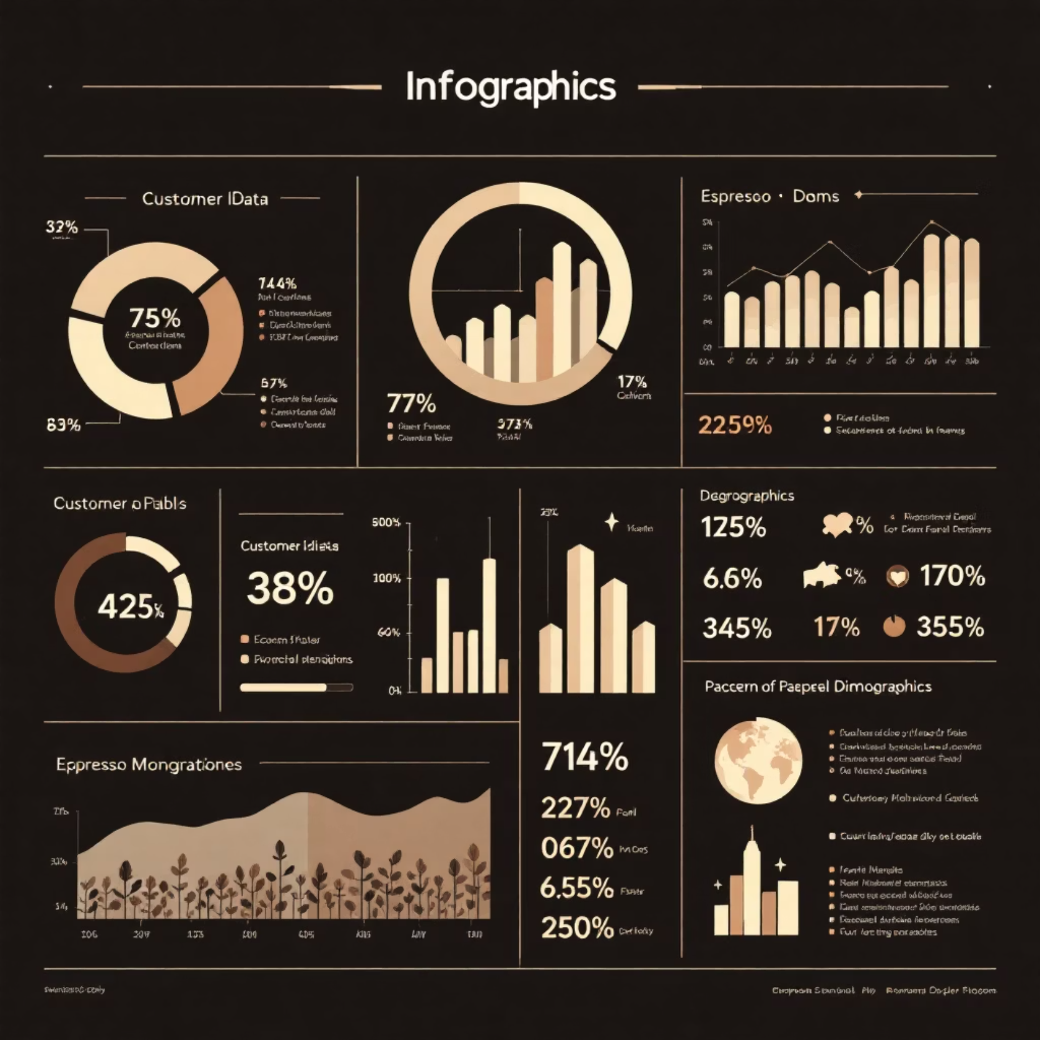
Dataset Summary & Key Features
Dataset Metrics
Rows: 3,900
Columns: 18
Missing Data: 37 values in Review Rating column
Key Feature Categories
Customer Demographics (Age, Gender, Location, Subscription Status)
Purchase Details (Item, Category, Amount, Season, Size, Color)
Shopping Behavior (Discount, Promo Code, Previous Purchases, Frequency, Review, Shipping)

Slide 4

Exploratory Data Analysis (EDA) in Python
The initial phase focused on data preparation, cleaning, and feature engineering.
Missing Data Handling
Data Loading & Exploration
Imputed missing Review Rating values using the median rating of each product category.
Imported dataset using pandas; checked structure with df.info() and summary statistics with .describe().
Database Integration
Standardization & Engineering
Connected Python script to PostgreSQL and loaded the cleaned data for SQL analysis.
Renamed columns to snake_case. Created age_group and purchase_frequency_days columns.

Slide 5
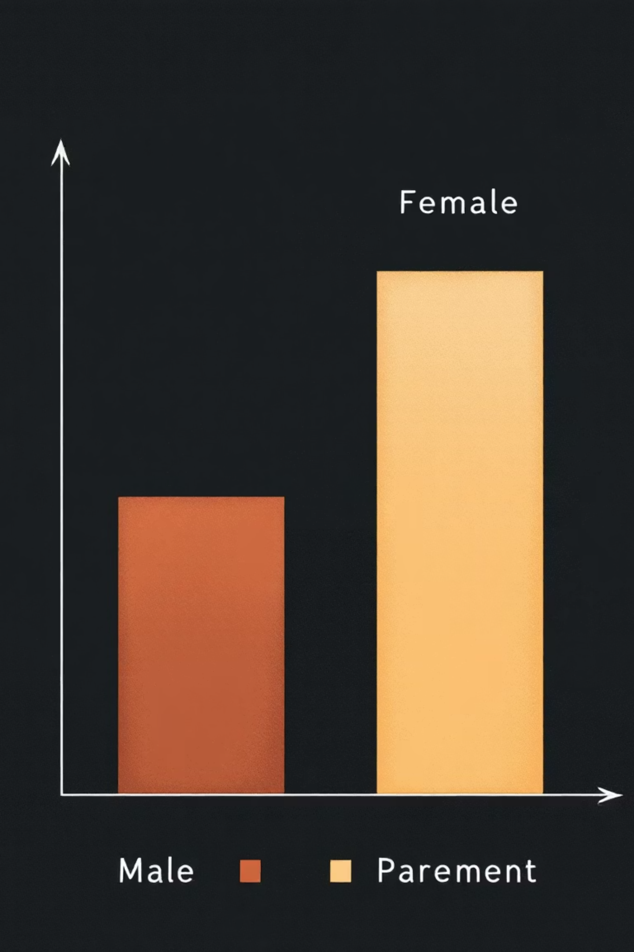
SQL ANALYSIS: KEY METRICS
Revenue and Spending Patterns
$157,890
$75,191
839
Male Revenue
Female Revenue
High-Spending Discount Users
Total revenue generated by male customers.
Total revenue generated by female customers.
Customers who used discounts but spent above the average purchase amount.
Male customers contributed significantly more to total revenue than female customers.

Slide 6

Product Performance and Shipping Insights
Top 5 Products by Rating
Shipping Type Comparison
1
Gloves (3.86)
Shipping Type
Avg. Purchase
2
Sandals (3.84)
Standard
$58.46
Express
$60.48
3
Boots (3.82)
Customers using Express shipping have a slightly higher average purchase amount.
4
Hat (3.80)
5
Skirt (3.78)

Slide 7

Subscription and Discount Dependency
Subscribers vs. Non-Subscribers
Top Discount-Dependent Products
Status
Customers
Avg. Spend
50%
Yes
1,053
$59.49
Hat
No
2,847
$59.87
49.66%
Non-subscribers account for the majority of customers and total revenue ($170,436 vs $62,645).
Sneakers
49.07%
Coat
48.17%
Sweater
47.37%
Pants

Slide 8
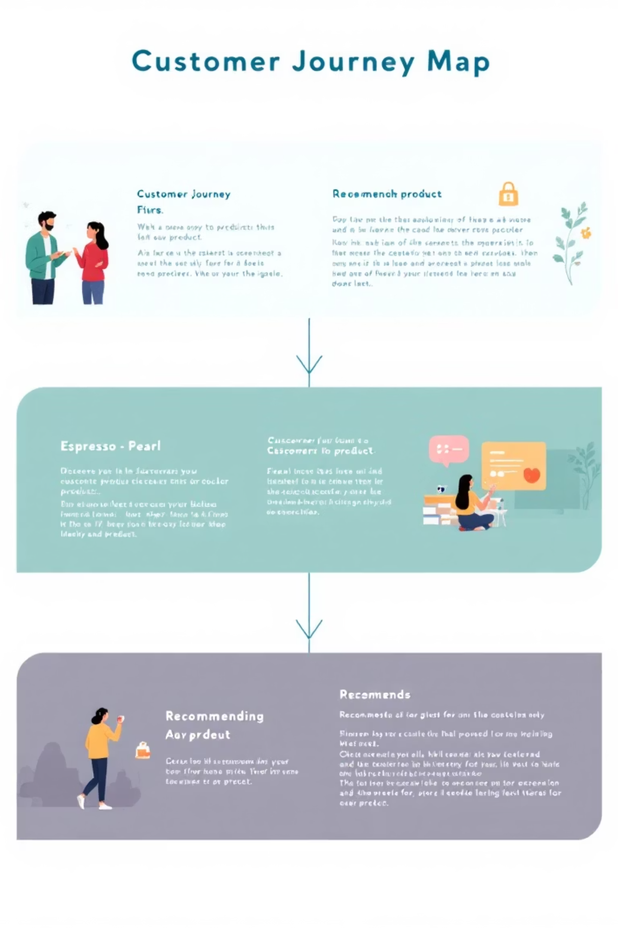
Customer Segmentation and Loyalty
Customers were classified based on purchase history, revealing a high concentration of Loyal buyers.
New
Returning
83 Customers
701 Customers
Loyal
3,116 Customers
Repeat buyers (those with >5 purchases) are less likely to subscribe (958 Yes vs. 2,518 No).

Slide 9




Top Products by Category
Identifying the most purchased items within the four main product categories.
Accessories
Clothing
Footwear
Outerwear
Jewelry (171 orders), Sunglasses (161), Belt (161)
Blouse (171 orders), Pants (171), Shirt (169)
Sandals (160 orders), Shoes (150), Sneakers (145)
Jacket (163 orders), Coat (161)

Slide 10

Strategic Business Recommendations
Boost Subscriptions
1
Promote exclusive benefits to increase conversion, especially among Loyal and Repeat buyers.
Customer Loyalty Programs
2
Implement rewards to further engage the large "Loyal" segment and encourage repeat purchases.
Review Discount Policy
3
Analyze discount usage on products like Hats and Sneakers to balance sales boosts with margin control.
Targeted Marketing
4
Focus efforts on high-revenue age groups (Young Adult) and Express-shipping users for maximum ROI.

